Slide 1

Topic: Two-Way Tables EQ: What are Two-Way tables and how do I read them?
Year 11 Essentials

Slide 2
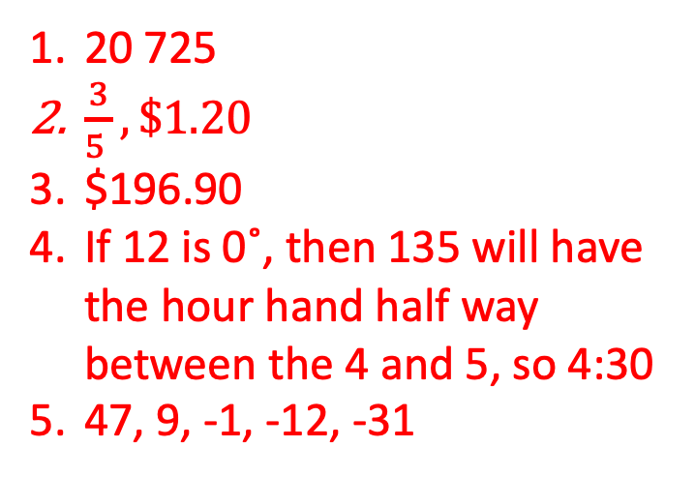
First 5
Topic: Two-Way Tables EQ: What are Two-Way tables and how do I read them?
32 160 – 11 435 =
Write 0.6 as a fraction. How much would 0.6 of $2 be?
How much will I pay for a $358 item that is marked 45% off?
What time will it be when the hour hand on a clock is at 135˚?
Write these numbers in order from largest to smallest; 47, -31, 9, -12, -1
20 725
$\frac{3}{5 }, \$1.20$
$196.90
If 12 is 0˚, then 135 will have the hour hand half way between the 4 and 5, so 4:30
47, 9, -1, -12, -31

Slide 3
Topic: Two-Way Tables EQ: What are Two-Way tables and how do I read them?
What is a two-way table?
Two-way tables are a simple way of showing multi-faceted data.
They are commonly used in information reports and it is important to know how to interpret them.

Slide 4
Topic: Two-Way Tables EQ: What are Two-Way tables and how do I read them?
The table below shows vehicles that were recorded going past a school over the course of one hour each day for a week.
 | Car | Truck | Bus | Motor-bike | Bicycle | Total
Monday | 34 | 2 | 1 | 6 | 17 | 60
Tuesday | 36 | 1 | 1 | 5 | 18 | 61
Wednesday | 33 | 3 | 1 | 6 | 16 | 59
Thursday | 40 | 0 | 1 | 2 | 15 | 58
Friday | 34 | 2 | 0 | 4 | 16 | 56
Total | 177 | 8 | 4 | 23 | 82 | 294
On which day where their the most trucks observed? On which day was the least trucks observed?
Which vehicles were the most common over the course of the week?
What can you tell about how the table is constructed? What do the numbers in each cell refer to? How about the totals for each rows or columns?

Slide 5
Topic: Two-Way Tables EQ: What are Two-Way tables and how do I read them?
TASK: Experiment
Page 92
Using the table above as a reference point.
Survey your class to find out how much study or homework each person did for each weekday over the past week did.
Use the data to create a two-way table with the days of the week and the amount of time spent on study or homework. Make sure that you consider how to categorise the amount of time spent.
What does it tell you about the study or homework habits of your class over the past week?
What questions could you ask about the data?
Finished? Complete apply on page 92 and 93.
Notes:
There is a fill in the blank two-way tables on connect.

